Slide 1

Social Work Legislations in Southeast Asia
Sri Lankan Experience of the SLAPSW Incorporation Act
- Amarawansa Ranaweera,
Past President of the SLAPSW

Slide 2
The following topics will be discussed in my presentation
Establishment of the SLAPSW
Legal status of the SLAPSW
Composition of the SLAPSW
Experience of the Parliament Act
Challenges in regulating Social work in Sri Lanka
Way forward

Slide 3
A brief history of the SLAPSW
Social work education commenced in Sri Lanka in 1952
Institute of Social Work established, and short-term training programmes were introduced
Diploma in Social Work started in 1962, Bachelor’s degree in 2005 and Master’s degree in 2008
The Sri Lanka Association of Professional Social Workers was formed in 1962 by a small group of Social Workers
It has received the membership of the IFSW in 1979
It has been functioning up to now passing through peaks and valleys. The Commonwealth Social Workers Association was formed during the IFSW World Conference held in Colombo in 1994

Slide 4
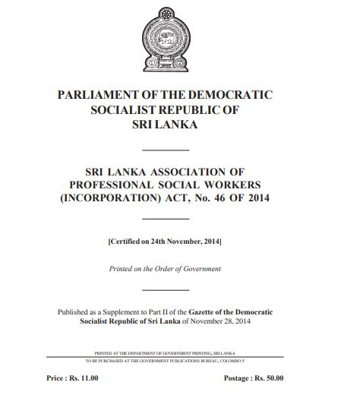
Legal status of the SLAPSW
The SLAPSW was registered as a volunteer organization under the Charity organization Act. in 1962
Then it was registered as an NGO at the Secretariat for Nongovernment organizations.
The SLAPSW was incorporated by an Act of Parliament in 2014
Benefits of Incorporation
    Asset protection
    Creation of corporate Identity
    Perpetual existence of the Association
    Transferability of ownership.
    Ability to build credit and raise funds
    Flexibility with appointing the management committees

Slide 5
The objectives as stated in the Act
Enhance and develop the professional social work
Create a link among persons engaged in social work
Provide training on the conduct of social work to the persons, engaged in carrying out social work.
Registration of members
Make by-laws for the conduct of matters of the Association
Elect a committee for the management and have annual general meetings
Conduct any programmes to achieve its objectives
To raise funds, receive funds, donations and maintain its own accounts
To recruitment of staff and maintain an office

Slide 6
Composition of the Association
Executive committee consisting of 15 members elected at the general meeting for a period of three years
The composition of the committee is President, Secretary, Treasurer, Vice President, Vice Secretary and ten other members
The membership categories
  Full membership, Associate membership, Student membership, Honorary membership
Life membership is given to full members with the approval of the executive committee. Others must pay an annual fee
District branches

Slide 7
Experience of the Parliament Act
The SLAPSW was recognized as a legal entity
It made us easier to function as an independent organization
First time, the Government recognized Social Work as a Profession
This Act of Parliament can be considered as a step for regulating social work in this country
It added more value to the SLAPSW
However, we experienced that, this Act of Parliament is inadequate to regulate Social Work in Sri Lanka
The SLAPSW has not given powers to act as a regulatory body in Social Work

Slide 8
Cont..
This Act does not define Social Work and Social Worker
Nothing mentioned about regulating social work and service categories coming under social work practice in the country
Nothing mentioned about professional standards, including those for proficiency, conduct and ethics
Nothing mentioned about standards for, accreditation and approval of education and training courses for Social Workers
Continuing education and professional development has not been made compulsory
We believe that we lobby and advocate for a National Legislation for social work in this country

Slide 9
Challenges in regulating Social Work in Sri Lanka
Lack of community awareness on the difference between charity and social work
Lack of awareness of policy makers about social work
Having a large social service workforce but not qualified to be included under the category of Social Work
Universities commenced degree programmes in Social Work with out following proper social work education standards
Lack of commitment of professionally trained social workers towards the development of the profession
Lack of funds for the lobbying and advocacy with evidence-based research

Slide 10
Way forward
The SLAPSW has been discussing this need with the authorities for some years. The National Institute of Social Development together with the SLAPSW has developed a road map for the development of a regulatory mechanism supported by UNICEF Sri Lanka. Under that we plan to;
  Identify a suitable mechanism for regulation of Social Work
  Develop proficiency standards
  Licensing social workers
  Develop a code of Ethics
  Develop a Social Work regulatory legislation suitable for Sri Lanka
Social work introduced to Sri Lanka about 70 years ago. It has a very slow but steady development. We need to reflect and understand the underlying forces for its slow development
Regularization of Social Work in Sri Lanka is a very challenging task
Thank you

